Slide 1


Slide 2
OVERVIEW
Need More Speed is an Arcade racing game for PC that revolves around night street racing scene and AI racers behaviour implemented using Machine Learning. The cars that player drives and races against are Remote controlled which are being driven on a tracks made on real roads. The player needs to race on different tracks and difficulty modes to unlock more cars and tracks. Radio stations will be playing modern Hip-Hop and EDM music.

Slide 3
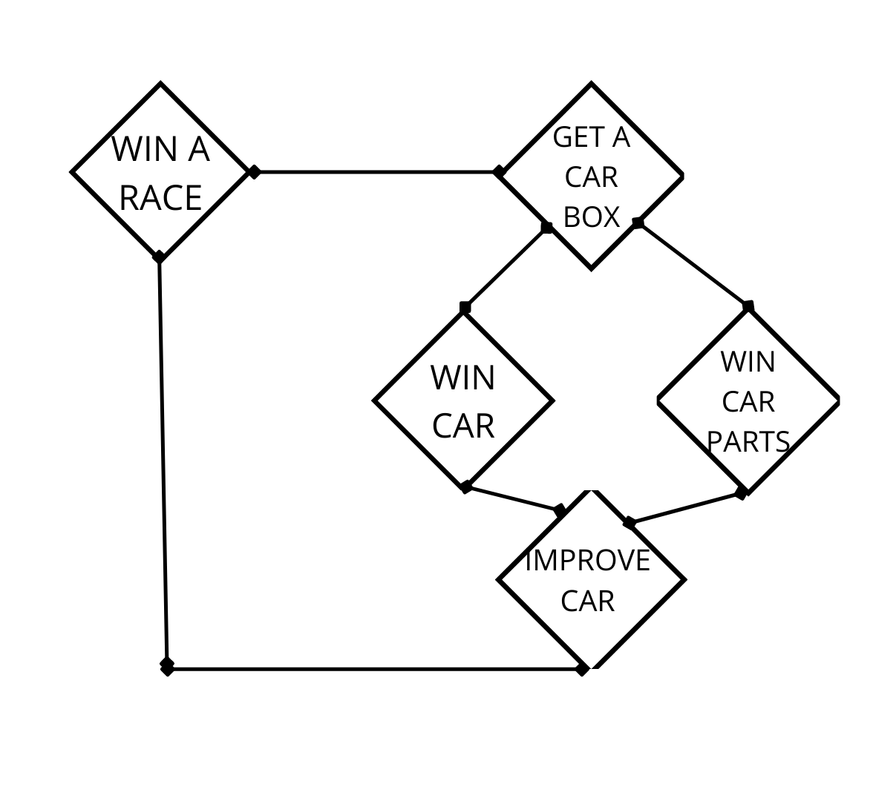
GAMEPLAY LOOP

Slide 4
GAME MECHANICS
New cars can be unlocked only through drop boxes, in which the probability of getting cars will be arranged according to the rarity of the vehicle.
Pickups in races will provide some power-ups if picked up, will give some advantage to the one who picked it over the rivals.
Winning a race has a chance to give either a car crate or an upgrade part which can be used to improve performance of current car.
Has a feature to create your own car where the player has the ability to merge multiple cars to make their own customized ride.
AI trained using Imitation and Reinforcement learning will provide a real player like behaviour when racing against NPC’s.
Give the ability to customize the ride according to the activity that the player wants to be engaged in. Some of these are:
-Street Builds: these will provide better cornering abilities.
-Racing Builds: These will provide better speeds.
-Drag Builds: Best for short, straight tracks.
-Drift Builds: Best suited for drift tracks.

Slide 5
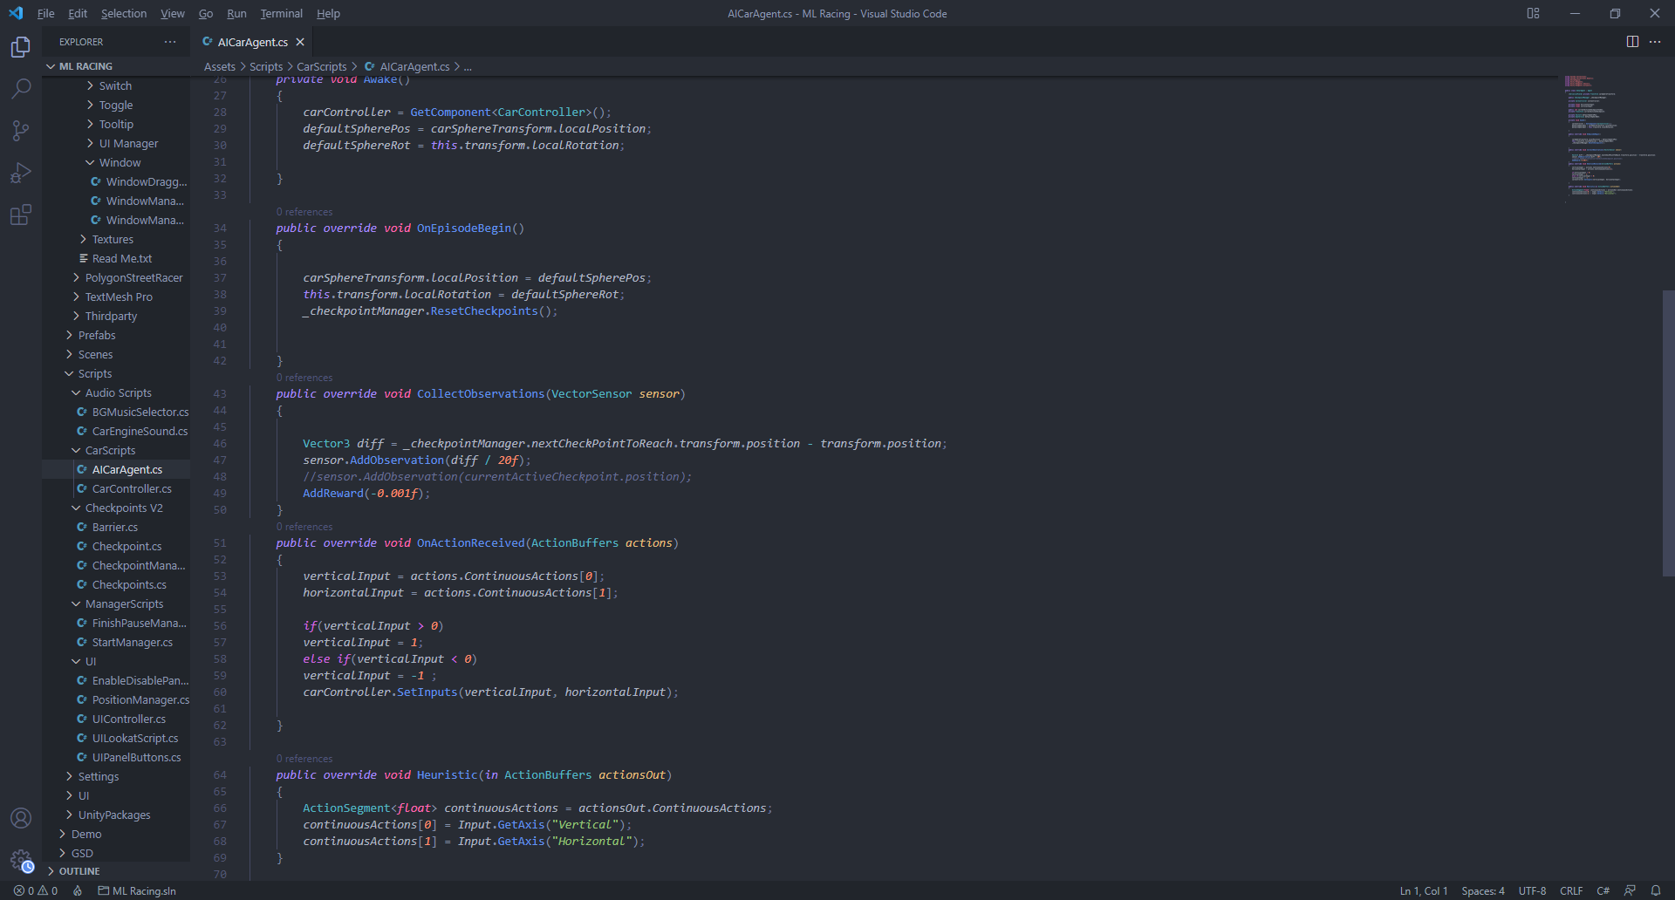
AI AGENT CONTROLLER

Slide 6
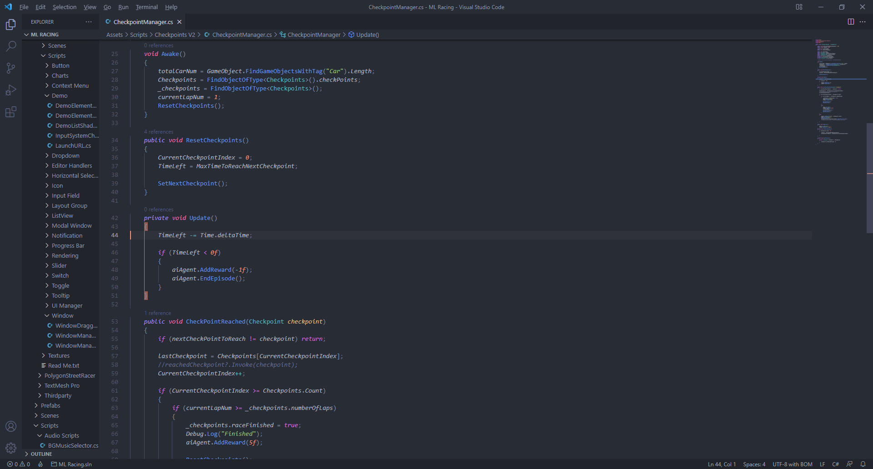
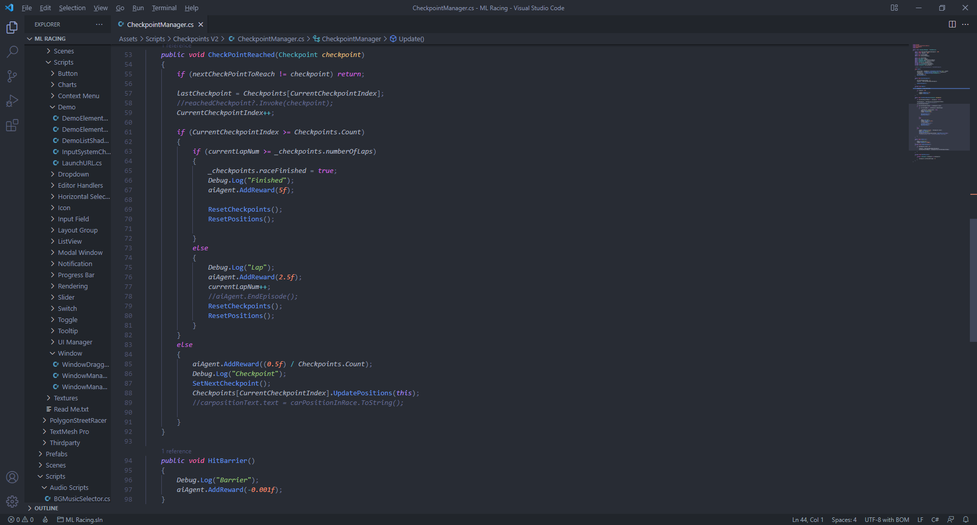
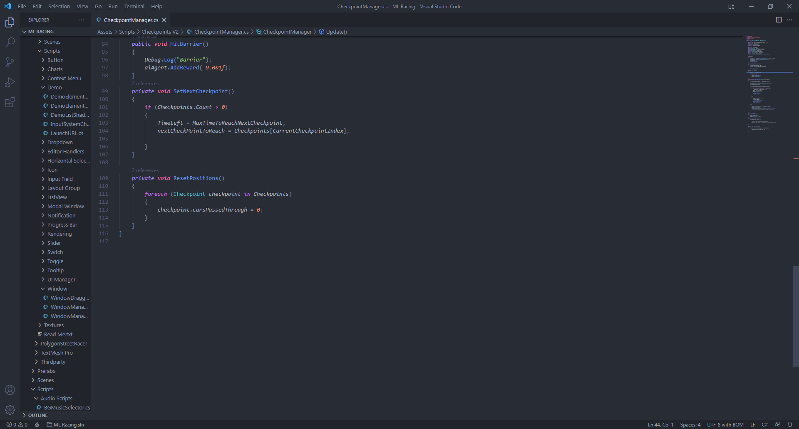
CHECKPOINTS AND
REWARD SYSTEM

Slide 7

THANK YOU

